Slide 1
Contract expiry notification bot
Done by Shanmuga Divya K , 220701261

Slide 2
Abstract
A contract expiry notification bot in RPA automates tracking and alerting stakeholders about upcoming contract expirations to ensure timely renewals or actions.

Slide 3
Need for the proposed solution
The proposed contract expiry notification bot addresses the critical need to eliminate manual tracking of contract deadlines, reducing the risk of missed renewals or penalties, enhancing efficiency, ensuring compliance, and improving stakeholder communication through timely and automated alerts.

Slide 4
Advantages of the proposed system
Ensures timely notifications about upcoming contract expirations, reducing the risk of missed deadlines and associated penalties.
Improved Efficiency: Automates repetitive tasks, freeing up employees to focus on more strategic activities.
Error Reduction: Minimizes human errors in tracking and managing contract timelines.
Enhanced Compliance: Helps organizations stay compliant with legal and contractual obligations by ensuring renewals or terminations are handled on time.
Cost Savings: Avoids penalties, fines, or revenue loss from missed contract renewals or lapses.
Centralized Monitoring: Provides a unified dashboard or tracking mechanism for managing multiple contracts efficiently.

Slide 5
Literature Survey
Advantages and disadvantages
Timely Notifications: Reduces the risk of missed deadlines and penalties by providing automated reminders.
Improved Efficiency: Frees up human resources by automating repetitive tasks, enhancing productivity.
Error Reduction: Minimizes manual errors in tracking contract deadlines.
Initial Setup Cost: Implementation and development of the bot may require significant initial investment.
Dependency on Technology: Over-reliance on automation might cause disruptions if the bot encounters technical issues.
Maintenance Requirement: Regular updates and monitoring are necessary to ensure the bot functions correctly.
Advantages:

Slide 6
Main Objective
The main objective of the contract expiry notification bot is to streamline and automate the process of tracking contract deadlines, ensuring timely notifications to relevant stakeholders to mitigate risks, enhance operational efficiency, and maintain compliance with contractual obligations.

Slide 7
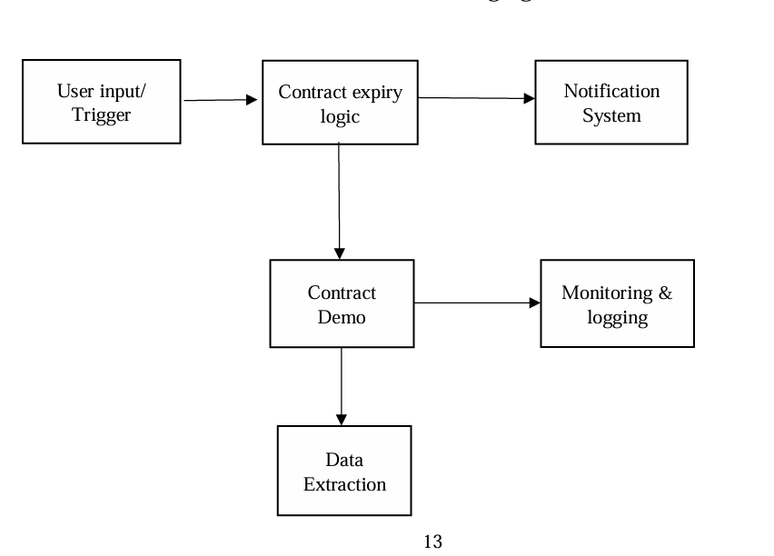
Architecture diagram

Slide 8
System Requirements
Hardware Requirements
Processor: Intel Core i5 or higher.
RAM: 8 GB (16 GB recommended).
Storage: 256 GB SSD or higher.
Network: Stable 10 Mbps connection
Software Requirements
OS: Windows 10/11 or Linux (Ubuntu 20.04+).
RPA Tools: UiPath, Automation Anywhere, or Blue Prism.
Database: SQL Server, MySQL, or PostgreSQL.
Notifications: Email (Outlook/Gmail) and messaging (Slack/Teams).
Cloud: AWS, Azure, or Google Cloud (optional).

Slide 9
Functional Description
Contract Data Retrieval: Fetch contract details (e.g., expiration dates, renewal clauses) from a database or document repository.Deadline Monitoring: Continuously monitor upcoming contract deadlines based on predefined rules (e.g., notify 30 days before expiry).Automated Notifications: Send alerts via email, SMS, or other communication channels to stakeholders.Escalation Management: Notify higher-level managers if no action is taken by the initial stakeholder within a set timeframe.Customizable Rules: Allow configuration of notification schedules, escalation rules, and stakeholder preferences.

Slide 10
Process Design
Main Process:
Trigger: Scheduled or event-based.
Fetch Data: Retrieve contract details.
Check Expiry: Compare current date with expiration dates.
Notify: Alert stakeholders about nearing deadlines.
Subprocesses:
Data Retrieval: Fetch contract data from repositories.
Notification: Send alerts to stakeholders via email/SMS.
Escalation: Escalate unresolved notifications to higher levels.
Logging and Reporting: Maintain records and generate reports

Slide 11
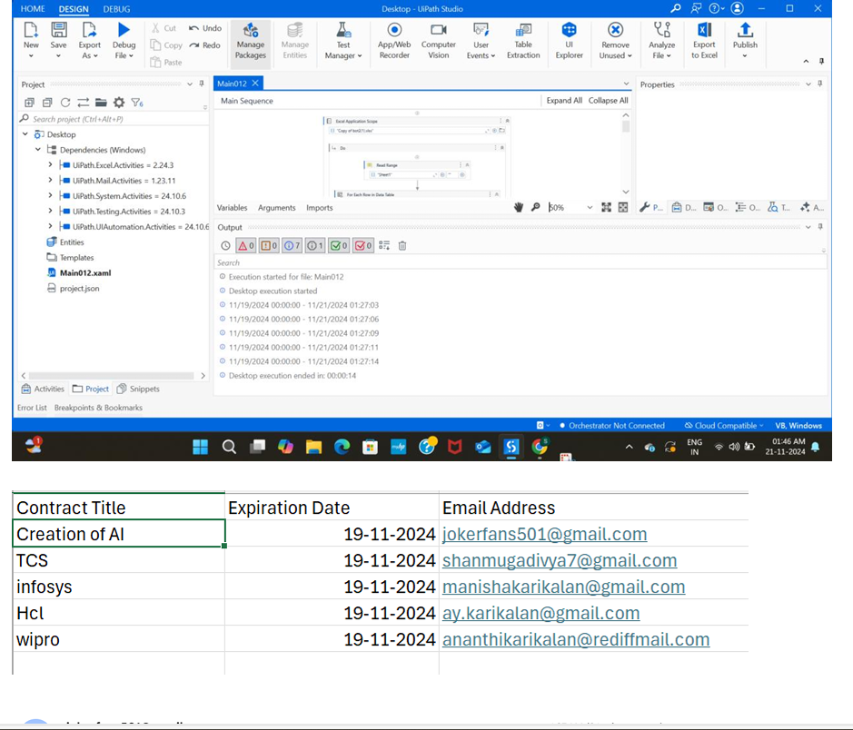
Output

Slide 12
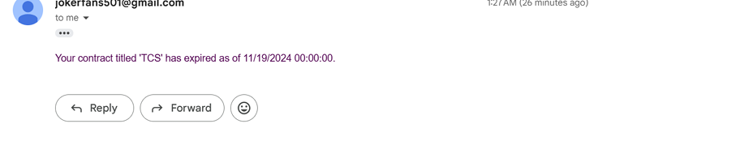

Slide 13
Conclusions
The Contract Expiry Notification Bot is a robust, efficient, and reliable solution designed to automate the monitoring and notification process for contract deadlines. By eliminating manual tracking, reducing errors, and ensuring timely stakeholder communication, it enhances operational efficiency and compliance. The system's scalability, customizability, and integration capabilities make it a valuable tool for organizations to mitigate risks, save costs, and maintain seamless contract management.

Slide 14
Future Enhancements
AI Contract Analysis: Automatically detect expiry dates, renewal clauses, and key terms using AI Customizable Notifications: Offer multi-channel alerts (email, SMS, push) with user-defined timings and frequencies . Renewal Alerts: Notify users with actionable insights for contract renewals, including summaries and renewal options . System Integration: Sync with contract management platforms to fetch and update contract details .Automation of Workflows: Pre-fill renewal documents and schedule contract negotiations automatically.

Slide 15
IEEE Paper
For IEEE Paper you can research on IEEE Xplore: https://ieeexplore.ieee.org/
Search by name project name and year

Slide 16
References
IEEE Xplore :Search for keywords like "Robotic Process Automation," "RPA," "Automation," "Bot," "Contract Management," and "Notification ."Explore papers on RPA applications in various industries, such as finance, healthcare, and IT . Look for case studies where RPA has been used to automate contract management tasks.

Slide 17
Thank you

